Slide 1

Towards a Provenance-Aware Internet of Things (IoT) System
Ebelechukwu Nwafor, PhD Candidate.
Department of Electrical Engineering and Computer Science (EECS)
Howard University
ebelechukwu.nwafor@bison.howard.edu

Slide 2
Outline
IoT
Data provenance
IoT Use Case
Research Contributions
Provenance-aware IoT system
SSN
PROV-O/PROV-DM
Efficient Provenance Storage
Experiment Evaluation
Conclusion
Future Work
Acknowledgement

Slide 3
What is IoT?

Slide 4
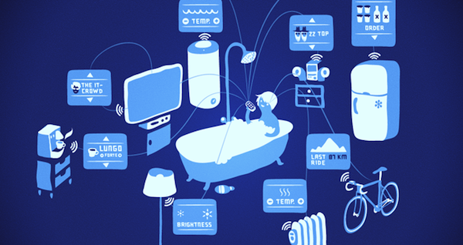
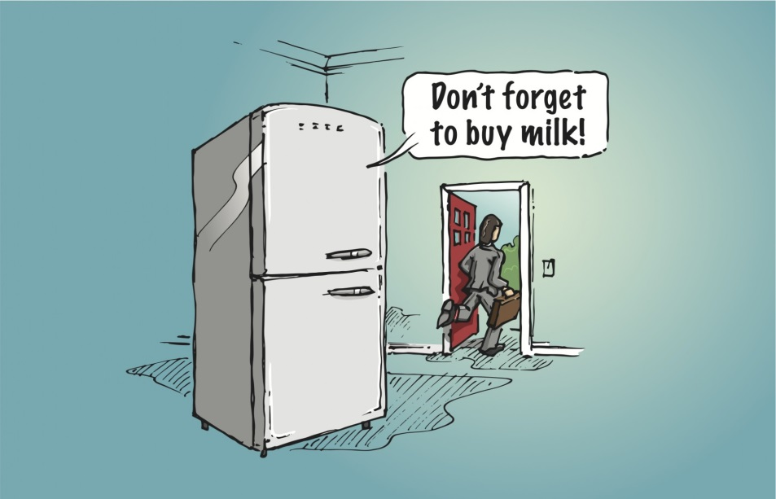
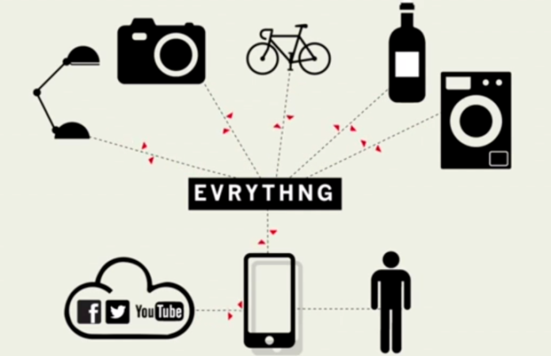
Internet of Things (IoT)
Heterogeneous device (sensors, actuators) connected over the internet.
According to Cisco, 50 million devices will be connected together by 2020¹
¹http://www.cisco.com/c/dam/en_us/about/ac79/docs/innov/IoT_IBSG_0411FINAL.pdf

Slide 5
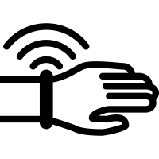

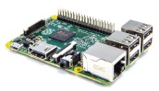

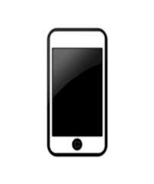
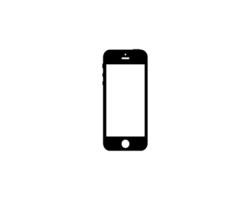


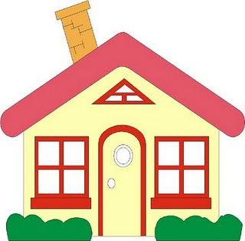
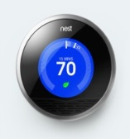
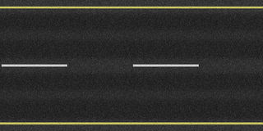


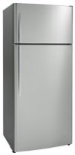


Applications of IoT
Smart Health
Machine to Machine Communication
Vehicle to Vehicle Communication
Home Automation

Slide 6
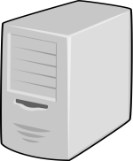
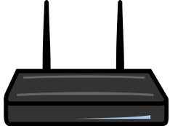
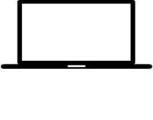
IoT Architecture
Cloud Layer
Gateway Layer
Increasing resource constraint
Device Layer
Sensor-Actuator Layer

Slide 7
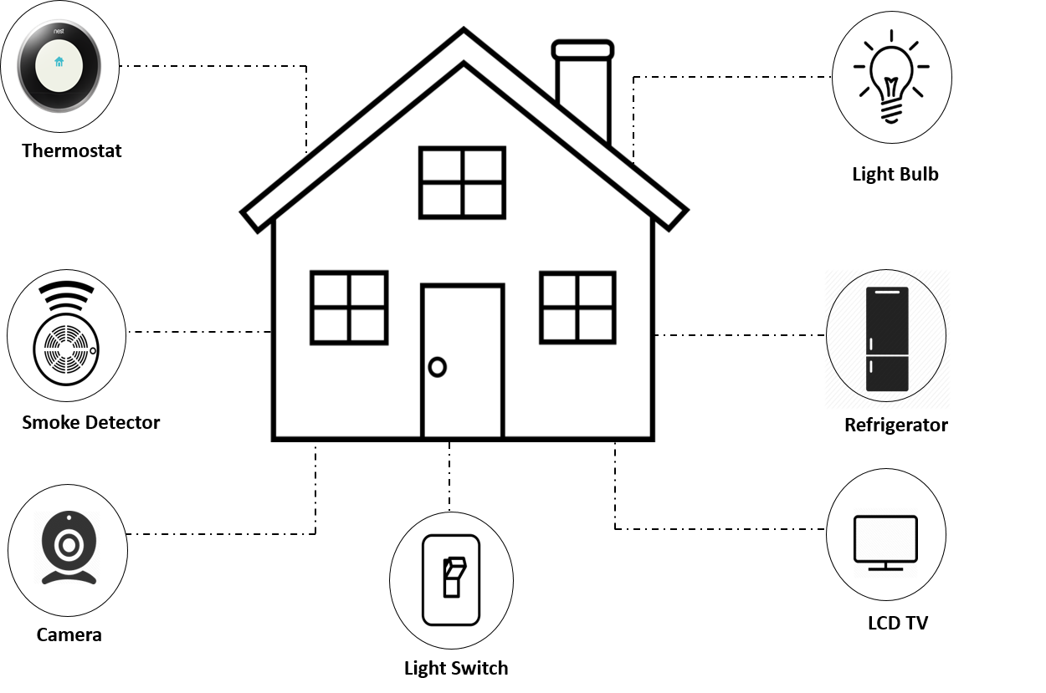
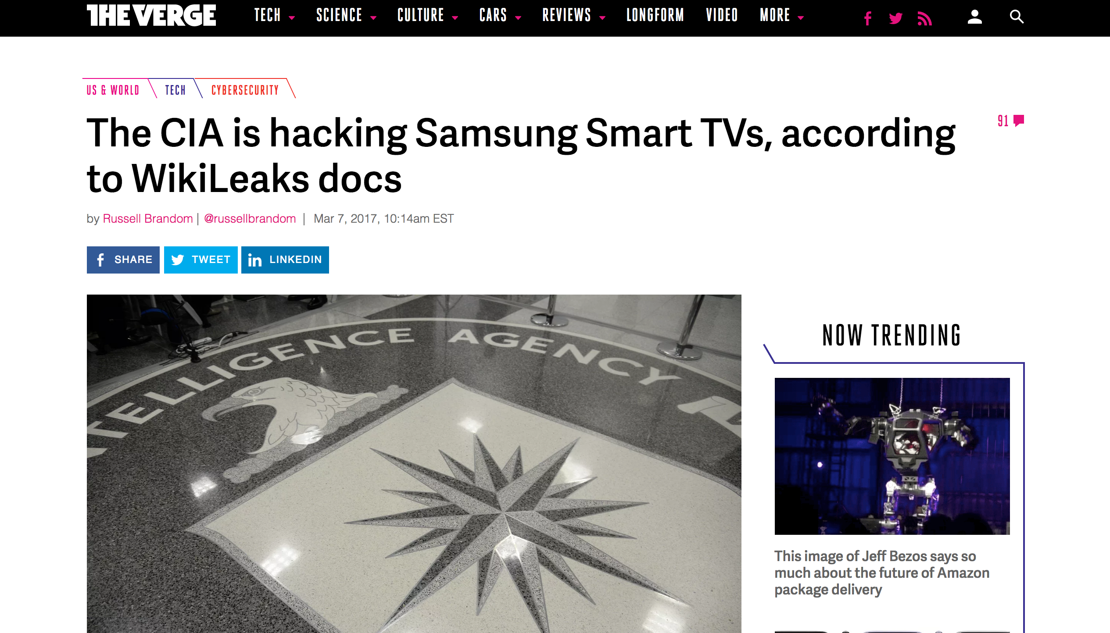

IoT use case: Smart Home
Creates a trail of activities
Helps detect malicious Intrusion

Slide 8
Data Provenance
Data provenance is a comprehensive history of activities that occurred on an entity from its creation to its current state
Entities: files, tables, tuples, process
Activity: Process of data modification e.g script, syscall, queries, commands.
Answers the who, where, what, when, and how of data transformation.

Slide 9
Data Provenance
Applications of Data Provenance
Audit Trail
Replication
Data Quality
Trust
Informational
Application Domain that uses Data Provenance
Scientific Workflow
Kepler
VisTrail
Chimera
Software Engineering
Version Control systems
Computer Security
Access Control
Intrusion Detection
Digital Forensics

Slide 10
Data Provenance
Represented via Directed Acyclic Graphs (DAG)
node: entity
edges: activity
Depicts dependency between entities.
A
p
F
f
v
k
m
B
h
C
w
E
Edges (activity)
z
g
Node (entity)
D

Slide 11
Differentiating Provenance, Log data, Metadata, Pedigree, and Lineage
 | Describes Data? | Shows Complete History? | Denotes data dependency?
Metadata
Log File
Provenance
Pedigree
Lineage
Notes:
Metadata is descriptive data about a data
Provenance is a type of metadata.
Log data contains information on which provenance to be created.
Lineage is a type of why provenance
Data pedigree represents the ancestry of data

Slide 12
Research Question and Objective
Research Question
Does provenance help provide intrusion detection for IoT?
Research Objective
To understand how provenance data can be used to provide intrusion detection to IoT.

Slide 13
Research Goals
How do we generate and model provenance in IoT?
Contribution: To develop a Provenance collection framework for IoT.
How do we store the vast provenance data on memory constrained IoT Devices?
Contribution: A policy driven framework for efficient provenance storage on IoT devices.

Slide 14
A Provenance collection framework for IoT.

Slide 15
IoT Challenges
There are no known provenance collection system designed for IoT.
IoT devices generates lots of data
Might contain unimportant data
Need to streamline data to derive knowledge

Slide 16
Overarching Goal
Raw Sensor-Actuator Data
[t1]{Data=d1, Device=r1, Sensor=s1}
[t2]{Data=d2, Device=r1, Sensor=s1}
[t3]{Data=d3, Device=r1, Sensor=s1}
[t4]{Data=d4, Device=r1, Sensor=s1}
Provenance Generation
Engine
Extract Data Features
Get Sensor Observations
Provenance Graph

Slide 17
Semantic Sensor Ontology (SSO)
W3C Standard for representing sensor information
Allows interoperability across various sensors platforms.
Consists of device , sensor and observation information
Observation and Measurements
contains readings of sensors (e.g temperature, pressure, Humidity).

Slide 18
PROV-O /PROV-DM
W3C Standard for representing provenance data
Allows interoperable data exchange between homogeneous environments (e.g Web)
Consists of Three major component
Entity
Activity
Agent
Serialized to:
RDF
JSON
XML
wasDerievedFrom
wasAttributedTo
Entity
actedOnBehalfOf
Agent
wasGeneratedBy
used
wasAssociatedWith
Activity
wasInformedBy

Slide 19
PROV-O and SSO
SSO defines sensor domain
Defines vocabularies, concepts and relationships between concepts
PROV-O denotes dependency between multiple entities (e.g sensors)
SSO and PROV-O can be aligned for better representation of dependencies in sensor data.

Slide 20
Prov-Sensor Model Alignment
[t1]{e1, Device=r1, sensor=s1}
[t7]{e7, Device=r1, sensor=s3}
[t2]{e2, Device=r1, sensor=s1}
[t8]{e8, Device=r1, sensor=s3}
[t3]{e3, Device=r1, sensor=s1}
AGENT
[t9]{e9, Device=r1, sensor=s3}
[t4]{e4, Device=r1, sensor=s1}
r1
[t10]{e10,Device=r1, sensor=s3}
used
used
used
AGENT
s1
s2
s3
[t5]{e5, Device=r1, sensor=s2}
wAW
wAW
wAW
[t6]{e6, Device=r1, sensor=s2}
ACTION
create
create
create
Contains
Temp, humidity, timestamp
wGB
wGB
e5
t5
wGB
wGB
wGB
wGB
wGB
wGB
wGB
ENTITY
e1
e2
e3
e4
e6
e7
e8
e9
e10
t6
t1
t2
t3
t4
t7
t8
t9
t10
wAW: wasAssociatedWith
wGB: wasGeneratedBy

Slide 21
IoT Provenance-Aware System Architecture
Sensor readings are intercepted by the Tracer to create a Trace File.
Trace Mapper converts the Trace File to PROV-O
PROV-JSON is stored in a graph database
PROV data is used as data for Provenance Application
Provenance
Application
Provdb
config
PROV
Tracer
Trace
file
Trace Mapper
I/O

Slide 22
IoT Provenance-Aware System Architecture
Sensor readings are intercepted by the barectf to create Common Trace Format(CTF).
Babeltrace converts CTF to PROV-JSON
PROV-JSON is stored in Neo4j
PROV-JSON is used as data for PIDAS.
Provenance
Application
(PIDAS)
neo4j
yaml
PROV
JSON
barectf
CTF
Babel
trace
I/O

Slide 23
Issues with Provenance Collection
Storage Overhead
Provenance generates significant amounts of data
Resource constraints on sensor/actuators.
Privacy and Security
Authentication
Integrity of Provenance data

Slide 24
Addressing Provenance Storage Overhead

Slide 25
Devices Size Specification
Device | Size
 | 256 KB FLASH 32 KB SRAM 6KB EEPROM
 | 512 MB
 | 32 KB FLASH 2KB SRAM 1KB EEPROM
TM4C 129
GOOGLE NEST THERMOSTAT
ADRIUNO UNO

Slide 26
Data growth over time
Data trace generated from a simple temperature and humidity sensing application.
Data grows as a rate of 30 bytes per second
2592 KB of raw data is generated in 24 hours

Slide 27
Compressing Provenance on Microcontroller
Compression algorithms implemented on raspberry Pi 3
Compression algorithm chosen based on Literature
LZW and Huffman produce a compression ratio of 1:6 and 1:2 respectively.

Slide 28
Provenance Storage using policy + LZW compression
We propose a policy-based approach to efficient provenance storage combined with data compression.
Allows flexibility of provenance storage
Only important Provenance data is stored
Noisy data is pruned before compression.

Slide 29
Efficient Provenance Storage Flowchart
PIDAS
neo4j
yaml
PROV
JSON
I/O
Tracer
CTF
Trace Mapper
Policy
Policy
Engine
Delete
No
Permit
Yes
Save

Slide 30
Provenance-aware Intrusion Detection and Analysis System (PIDAS)
An IDS implementation using provenance data.
Consists of three components
Collector
Detector
Rule-built
Rule-match
Warning Report
Analyzer
Query DB for provenance data

Slide 31
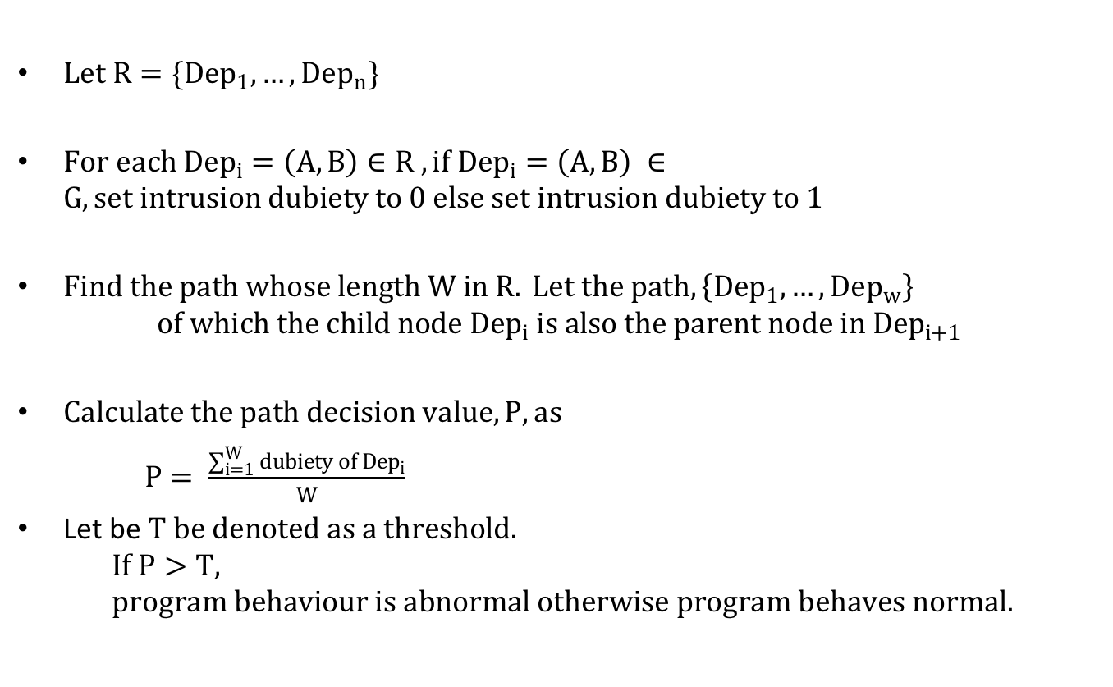
PIDAS Detection algorithm
$Let R=\{{Dep}_{1},…,{Dep}_{n}\}$
$For each {Dep}_{i}=\left(A,B\right)∈R , if{ Dep}_{i}=\left(A,B\right) ∈G,set intrusion dubiety to 0 else set intrusion dubiety to 1$
$Find the path whose length W in R. Let the path,\left\{{Dep}_{1},…,{Dep}_{w}\right\}$
$$of which the child node {Dep}_{i} is also the parent node in {Dep}_{i+1}$$
$Calculate the path decision value, P, as$
$P= \frac{\sum_{i=1}^{W}{dubiety of {Dep}_{i}}}{W}$
Let be $T be denoted as a threshold.$
$$If P>T, program behaviour is abnormal otherwise program behaves normal.$$

Slide 32
PIDAS Detection algorithm
A
p
A
0
A
F
p
F
F
A
F
f
v
k
0
0
0
f
v
k
B
B
B
B
m
0
h
m
C
C
C
C
w
E
1
E
w
E
z
g
E
D
D
path whose length is W
C->A->F
C->B->A->F
C->B->F
C->B->E
Application’s observed behavior
Observed system behavior

Slide 33
Summary
IoT and Provenance Introduction
Motivation for a Provenance-Aware IoT System.
Efficient storage of provenance data using policy and data compression techniques

Slide 34
Future Work
Securing Provenance
Ensuring Confidentiality and the integrity of provenance data.
Provenance and Privacy
How do we ensure that the vast amount of data collected is not invasive to privacy
Recovering provenance from incomplete dependency graph

Slide 35
Acknowledgement
Dr. Gedare Bloom, Assistant Professor, EECS, Howard University.
Andre Campbell, Undergraduate, EECS, Howard University
David Hill, Undergraduate, EECS, Howard University

Slide 36
Thank You!

Slide 40
Data Provenance
Provenance Forms
Observed Provenance
Provenance automatically collection from system or application events
Disclosed Provenance
Describe workflow and provide execution engine.
Provenance Granularity Level
Fine-Grained
Detailed level of provenance collection
Coarse-Grained
Summarized provenance collection

Slide 41
Barectf
Command-line generator of C-tracers which outputs common Trace Format (CTF)
Bare metal tracing for Microcontrollers without OS.
Barectf Workflow
barectf.c
config.yaml
barectf
User application
CTF
barectf.h

Slide 42
Tools and Applications Utilized
Tracer
Barectf: collects provenance trace in Microcontroller
Trace Mapper
BabelTrace: converts CTF to PROV-DM
Raspberry Pi
Microcontroller
Neo4j
Graph database for provenance storage.

Slide 43
Common Trace Format (CTF)
CTF is a binary trace format that allows traces to be written fast
Composed of stream of binary events
Allows tracing of application written in C/C++
Stream may be sent over a network
Stream may be parsed in memory
Stream objects contains
Header
Stream context
Event
Payload

Slide 44
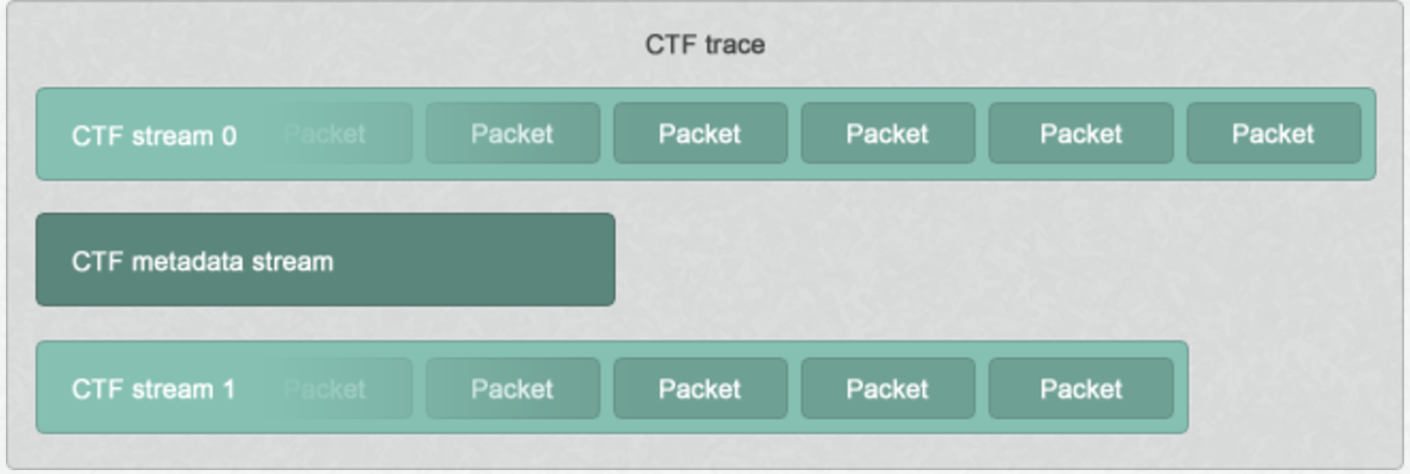
CTF Trace/ Packet
Source: http://diamon.org/ctf/

Slide 45
CTF EVENT
Contains data for which trace is collected.
Specified in yaml configuration
Contains data types
Integer
Floating-point
String
Enumerations
Array

Slide 46
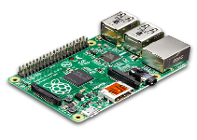

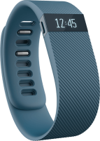

Data Aggregation
Cloud Layer
●
Gateway Layer
Decreasing resource constraint
●
●
Device Layer
●
●
●
●
●
Sensor-actuator layer

Slide 47
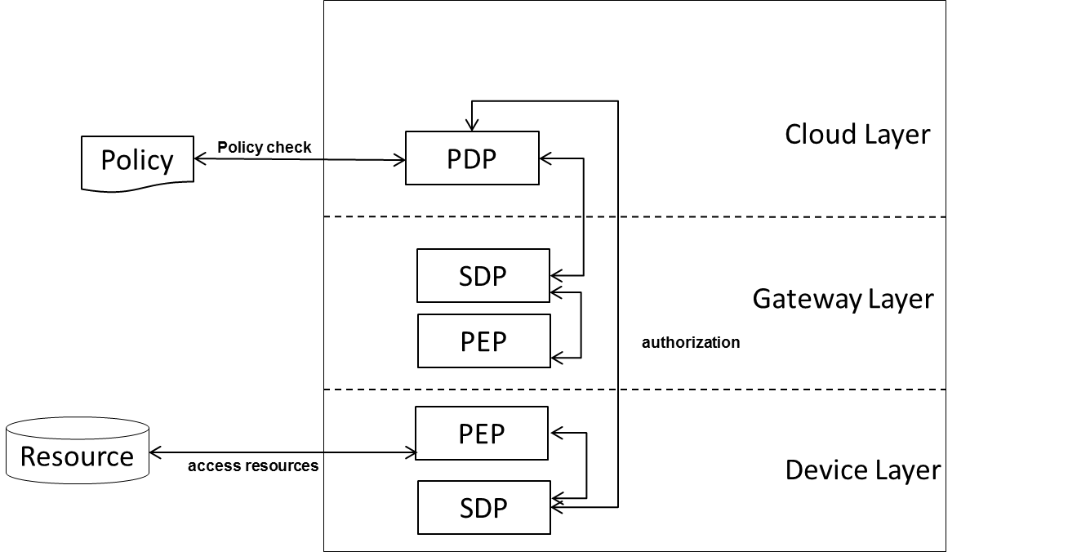
Policy-based System Architecture

Slide 48
Policy-based System Architecture
Policy Administration Point (PAP)
Generates policy documents.
Policy Enforcement Point (PEP):
Generates request and enforces authorization received from the PDP.
The Policy Decision Point(PDP):
Evaluates policy based on the request received from the PEP.
Secondary Decision Point(SDP):
A second version of the PDP.
Allows for distributed policy evaluation

Slide 49
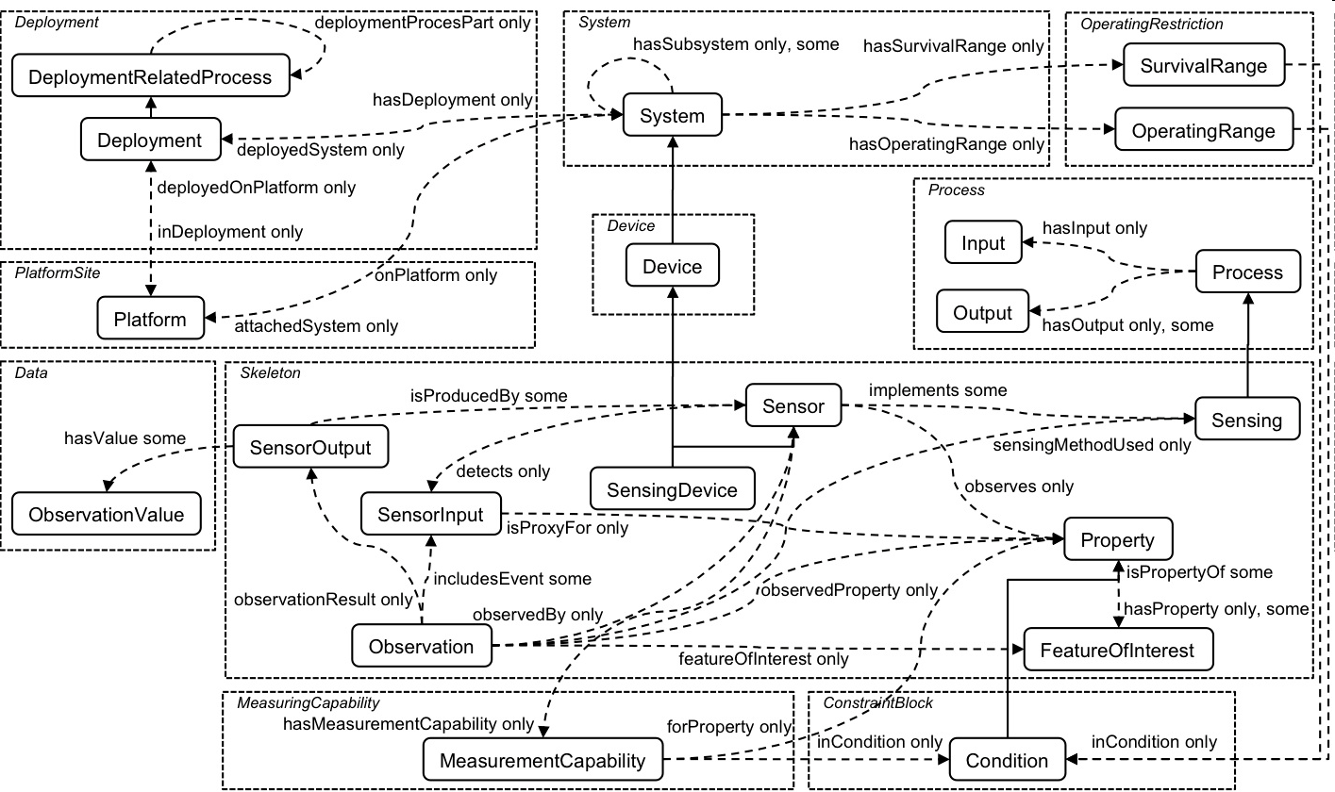
SSN-O

Slide 50
Experiment Evaluation
Provenance data is collected using application use case.
Frameworks are evaluated using PIDAS.
False positive rate
True positive rate
Throughput
System overhead incurred

